Slide 1


LAPD Crime Data from 2020-3/1/23 Analysis and Recommendations
Authors: Jose Aviles, Desarie Gonzales, Javier Gutierrez, Patricia Santana, Abby Ruiz, Marko Vuksanovic
California State University, Los Angeles
BUS 5100-93 Intro to Business Analytics

Slide 2
Overview
Crime Data from the City of Los Angeles 2020 to 3/1/23
Why it's important?
Data Cleaning
Visual Charts (Pie & Bar)
Regression Analysis
Predictive Analysis
Time-series
Geo Map
Recommendations based on the data for LAPD

Slide 3

Why it’s important?
21 Community Police Stations within LAPD
Ensure resource allocation aligns with criminal activity
Strategically deploy refresher training based on trends
Ensure that police officers are able to effectively resolve or reduce problems for the benefit of those who live and work there.

Slide 4
Data Set Cleaning
Downloaded Crime activity in Los Angeles
Prepared data:
Removing unneeded columns
Fusing Dates with Military time
Adding a Count Columns to facilitate stories
and reducing data errors
167.9 MB
Data source: (https://catalog.data.gov/dataset/crime-data-from-2020-to-present) Size: 164MB

Slide 5
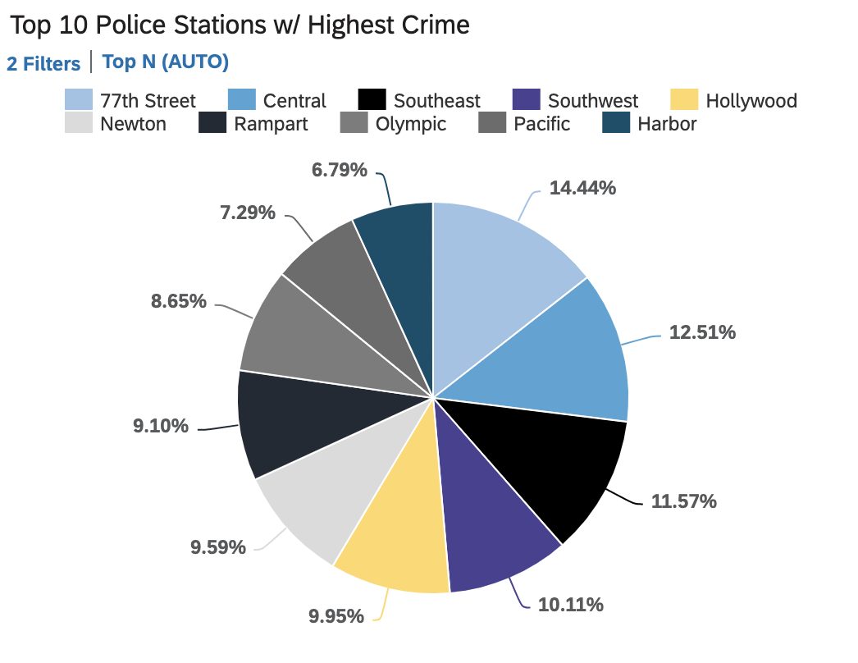
Pie Chart Analysis

Slide 6
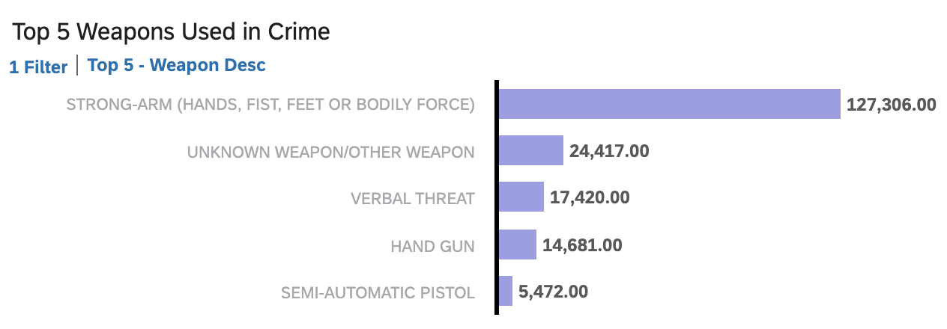
Bar Chart Analysis

Slide 7
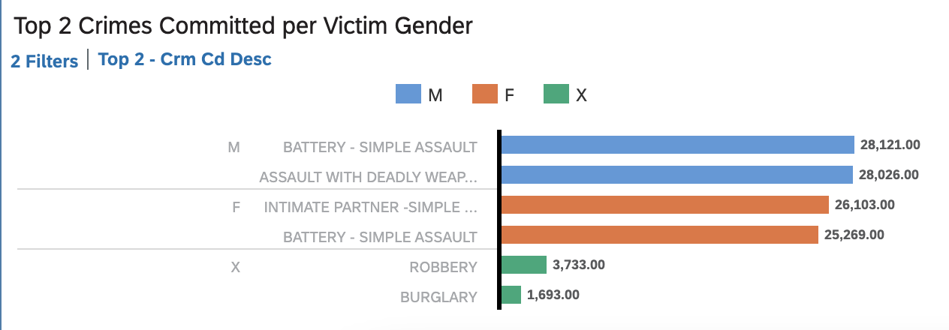
Bar Chart Analysis

Slide 8
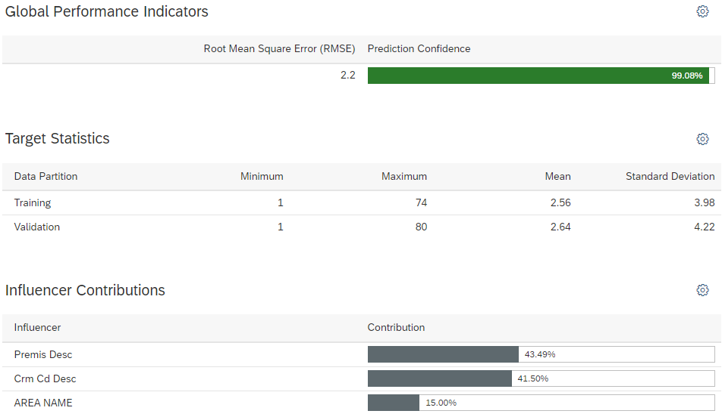
Regression Analysis

Slide 9
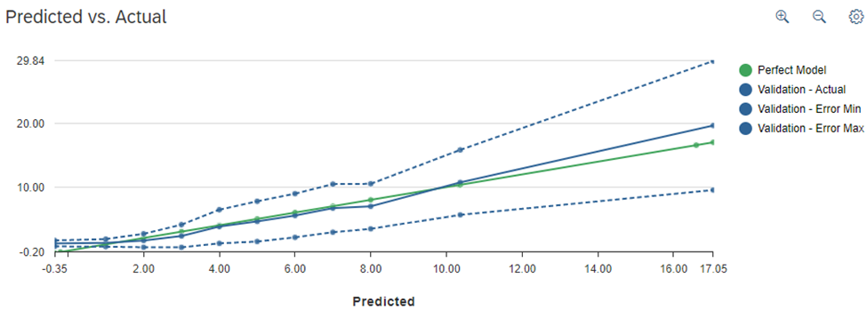
Regression Analysis Predicted vs. Actual

Slide 10
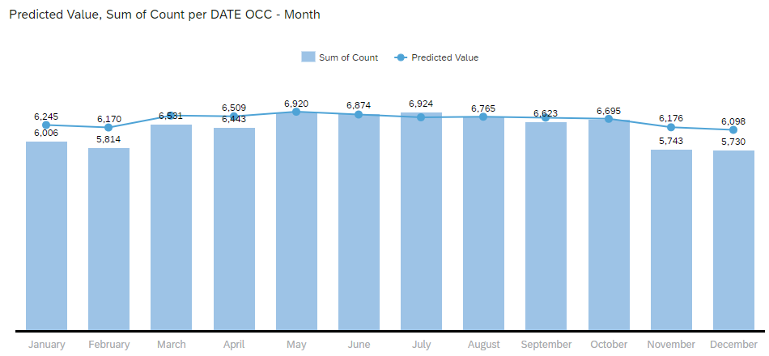
Predictive Analysis
Value by Month

Slide 11
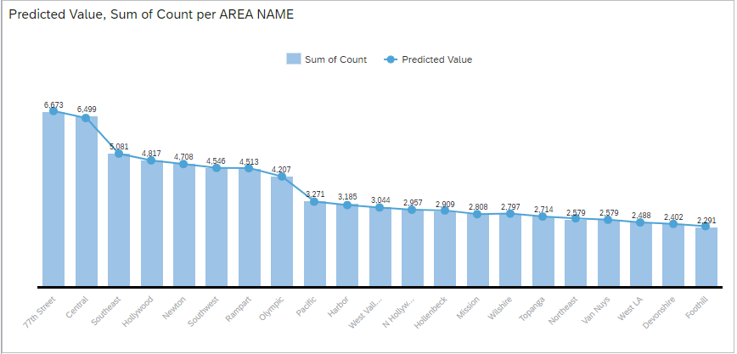
Predictive Value by Area
Area Trends:
Top Two Highest Crime Count
1. 77th Street
2. Central
Top Two Lowest Crime Count:
Foothill
Devonshire

Slide 12
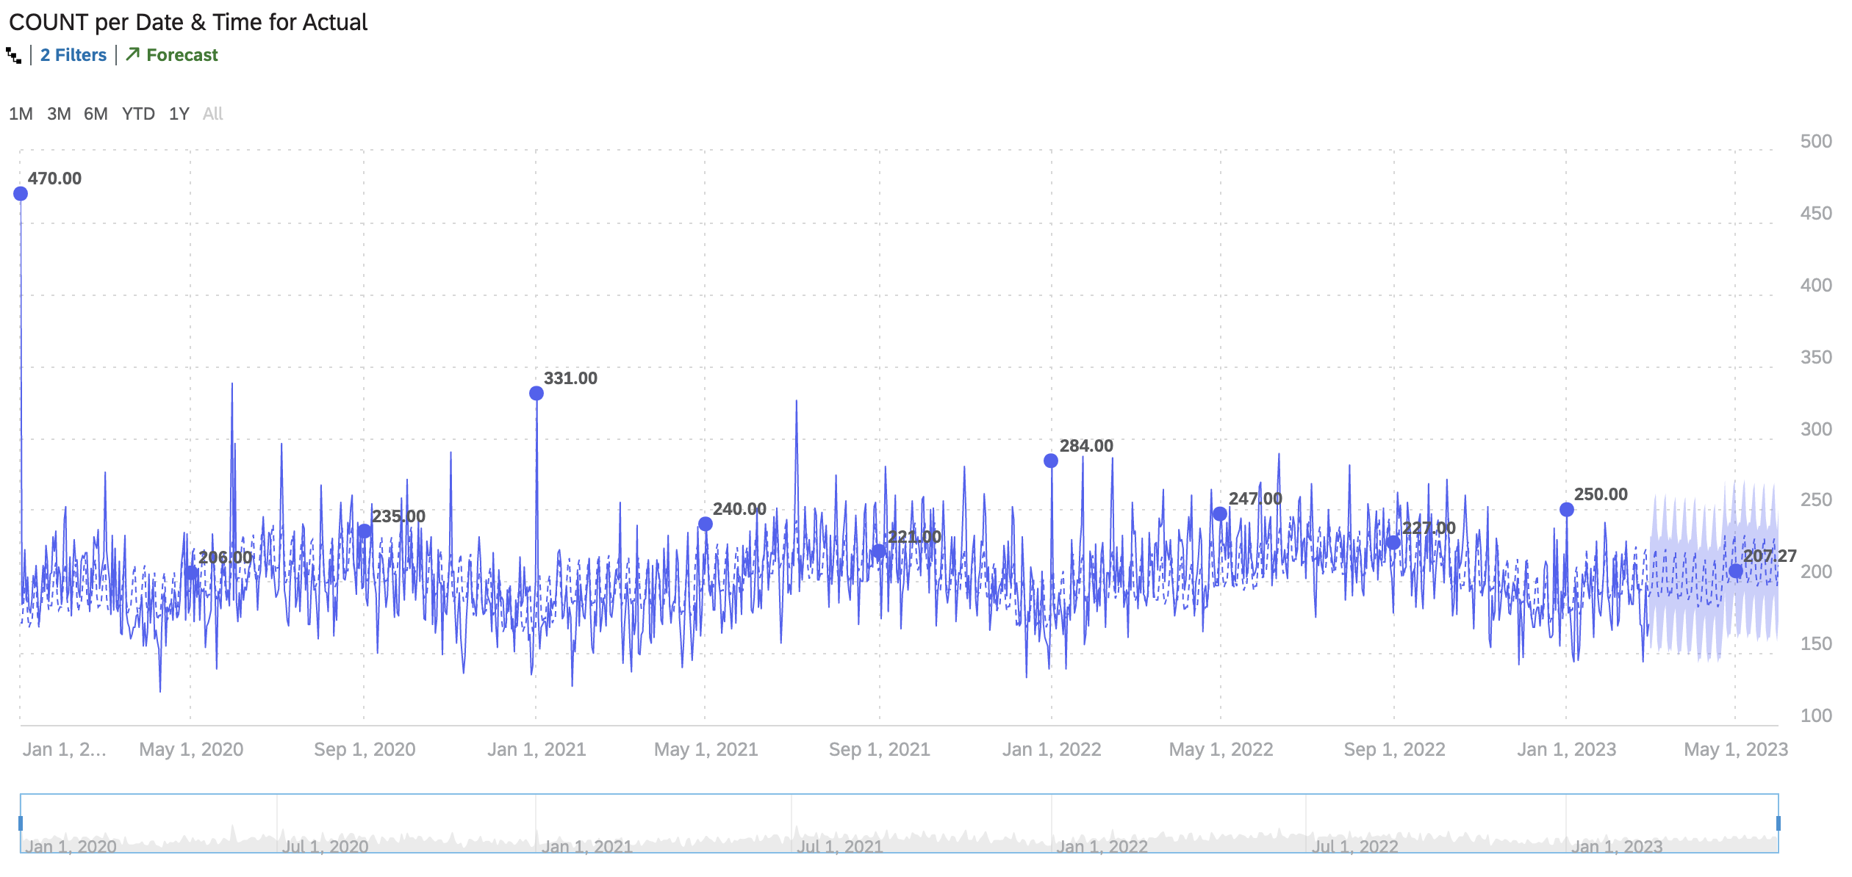
Time Series Analysis and Forecast
May 30th, 2020
January 1st
New Years
July 4th
Independence Day

Slide 13
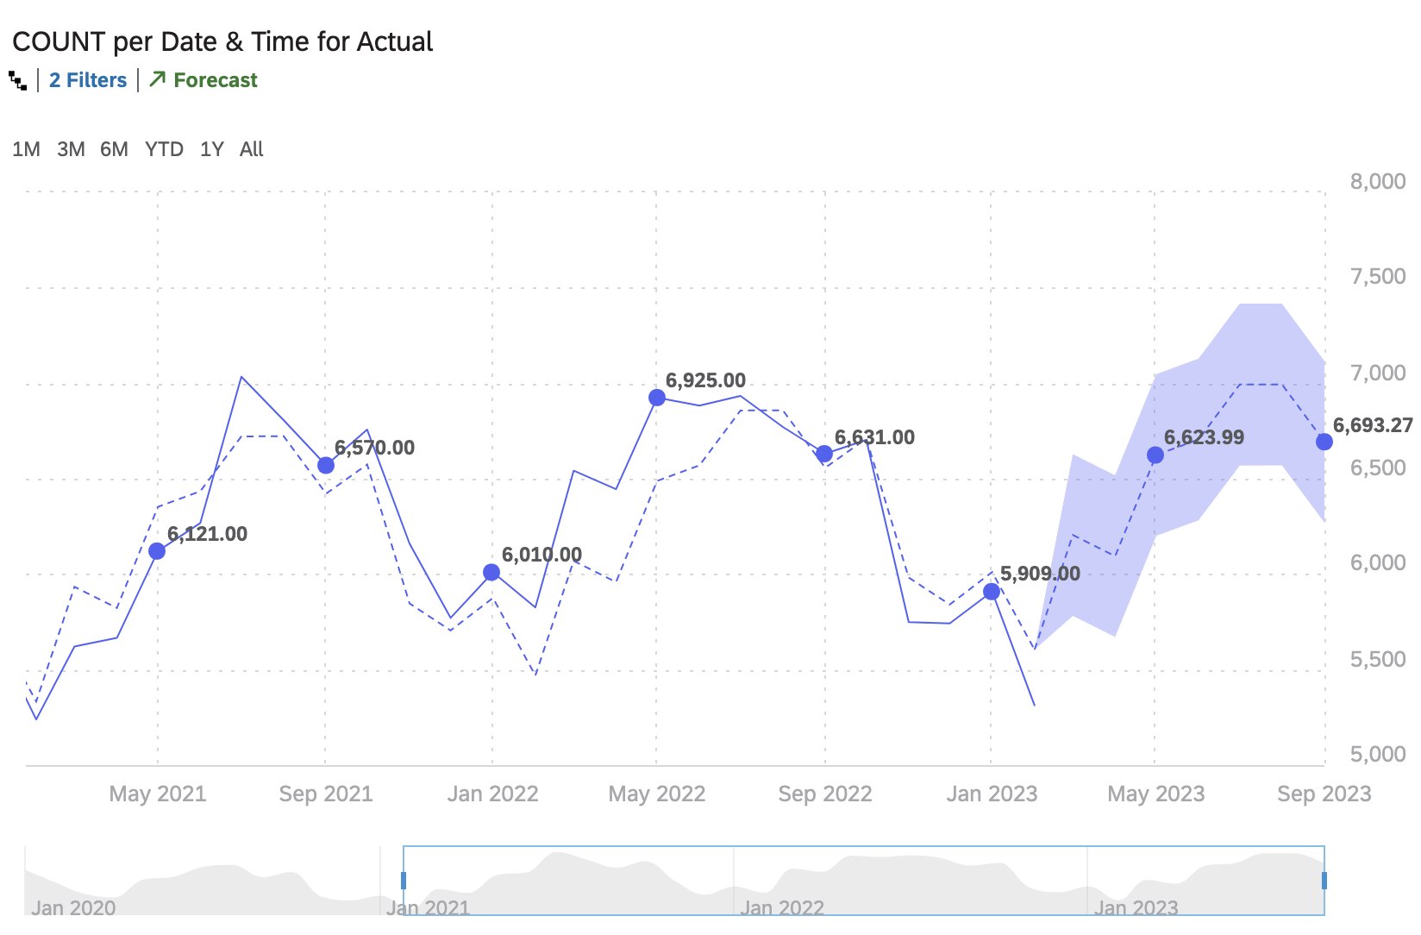
Time Series Analysis and Forecast

Slide 14
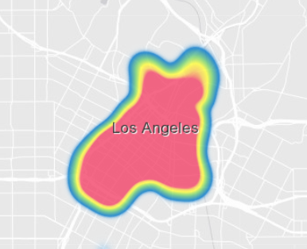
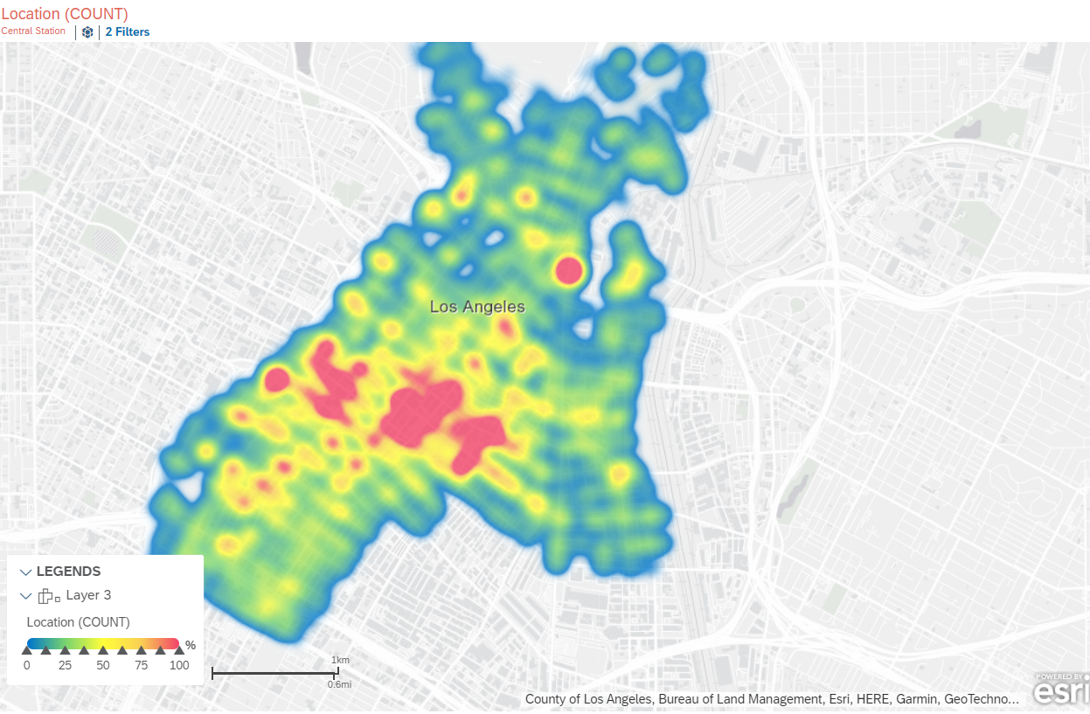
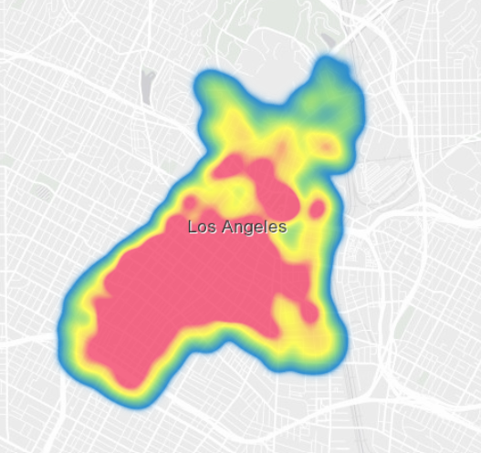
LAPD Central Station (251 E 6th St, Los Angeles, CA 90014)
GEO Map

Slide 15
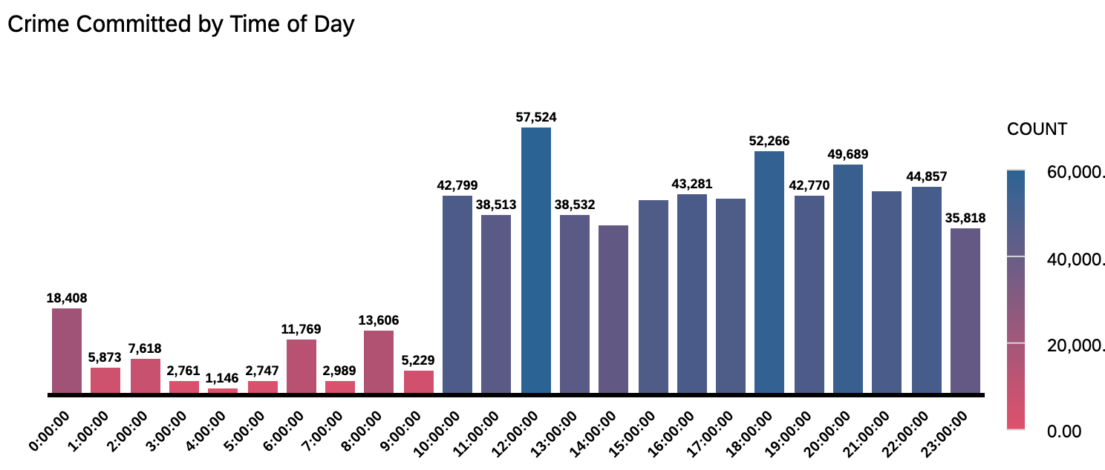
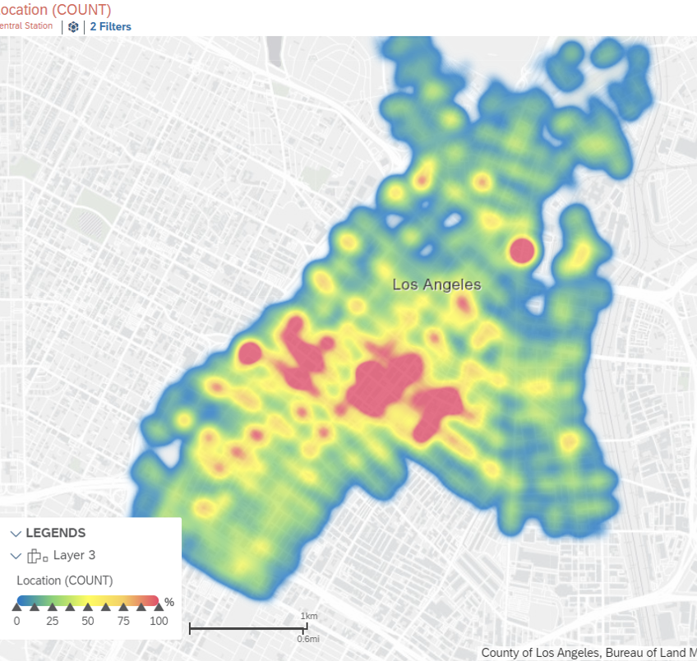
Crime Committed by Time of Day and Tempo-Spatial Analysis

Slide 16
Current Training Requirements
Police officers in the United States average 652 basic training hours, 52 hours of field training and 21 hours of in-service hours.
In comparison, California requires 664 hours of basic training hours, 0 field training hours and 12 yearly in-service hours.

Slide 17
California Required Refresher Training
Annually:
High Speed Vehicle Pursuits
Electronic Surveillance “periodic recertification” as set by the AG
Blood borne pathogens
Respiratory protection/fitting
Bi-annually:
Domestic Violence Complaints
First Aid and CPR/AED
Perishable Skills Program (PSP) consists of 12 hours of psychomotor, 2 hours of communications, and 4 hours of use of force training every 24 months.
· Category I - Tactical Firearms - 4 hour minimum
· Category II - Driver Training/Awareness - 4 hour minimum
· Category III - Arrest & Control - 4 hour minimum
· Category IV - Strategic Communications - 2 hour minimum
· Category V - Use of Force - 4 hour minimum
Every 5 years:
Racial and Identity Profiling

Slide 18
Recommendations to City of LAPD
Train all Police Officers on Verbal Judo
Increase Domestic Violence training to annual
Increase Use of Force training to annual given that the top 2 crimes committed against both males and females are related to assault and battery
Increase patrolling at 12 pm and at 6p, especially in hot spot areas identified in crime heat map

Slide 19
Thank you!

